Slide 1



Forces in space
Module 1: System of Forces

Slide 2
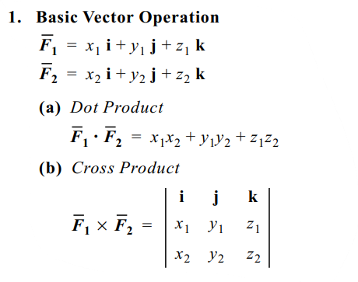

Vectors

Slide 3

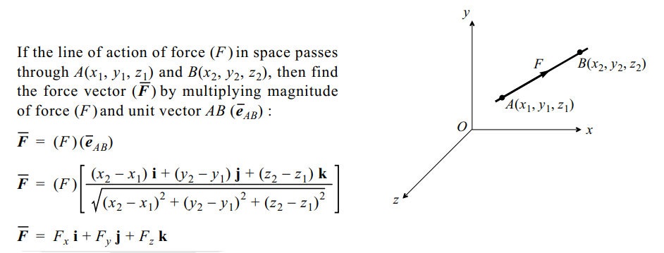
Force Vectors
Fig. 1 Force Vector
Fig. 1 Force Vectors^{[1]}

Slide 4
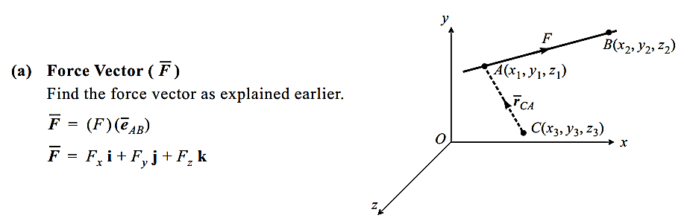
Moment Vector (Moment of a force about a given point)
Fig 2: Moment of a force
Fig 2: Moment of a force^{[2]}

Slide 5
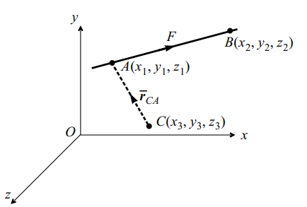
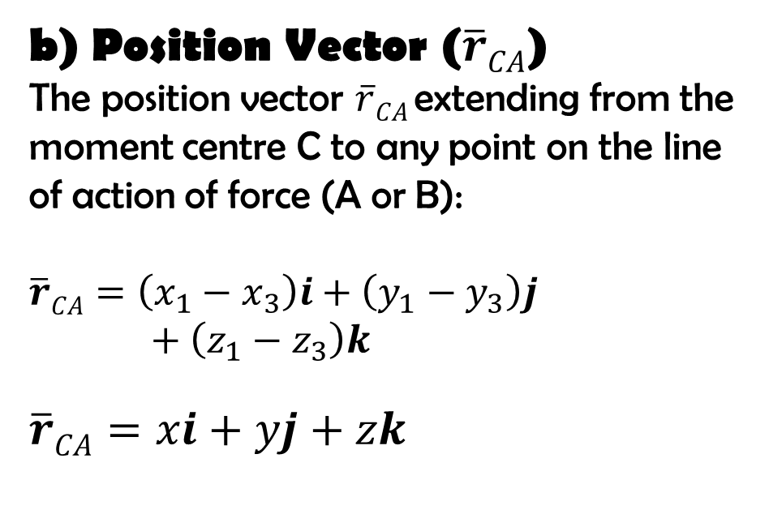
Moment Vector (Moment of a force about a given point)
b) Position Vector ($\overline{r}CA$)
The position vector $\overline{r}CA$extending from the moment centre C to any point on the line of action of force (A or B):
$$\overline{r}CA=\left(x_{1}−x_{3}\right)i+\left(y_{1}−y_{3}\right)j+\left(z_{1}−z_{3}\right)k$$
$$\overline{r}CA=xi+yj+zk$$
Fig 2: Moment of a force
Fig 2: Moment of a force^{[2]}

Slide 6
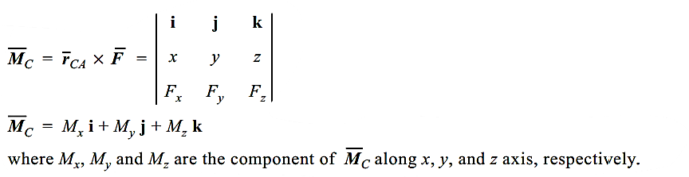

Moment Vector (Moment of a force about a given point)
C) Moment Vector ($\overline{M}C$)
The cross product of position vector $\overline{r}CA$ and the force vector $\overline{F}$ to obtain the moment centre $\overline{M}C$
Fig 2: Moment of a force
Fig 2: Moment of a force^{[2]}

Slide 7
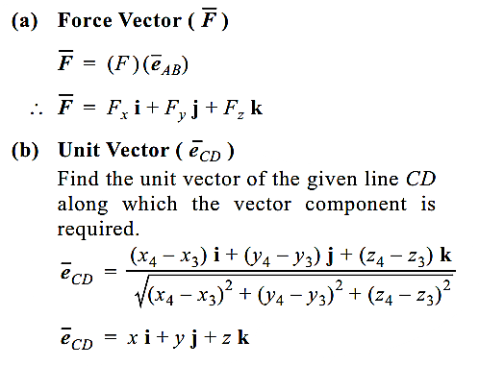
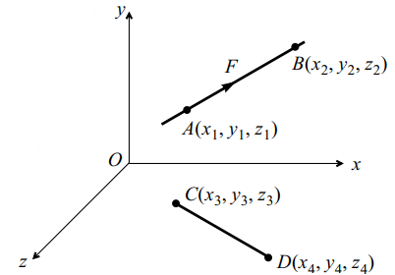
Vector components of a force about a given line
Fig 3: Vector components of a force
Fig 3: Vector components of a force^{[2]}

Slide 8
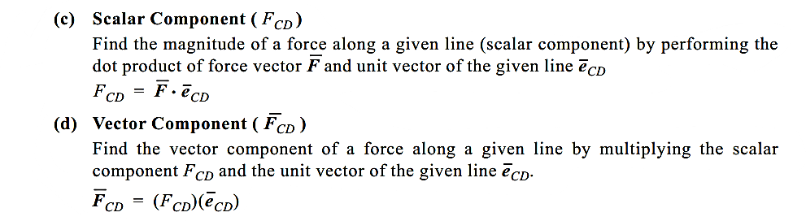
Vector components of a force about a given line
Fig 3: Vector components of a force

Slide 9
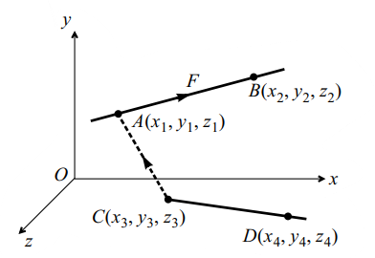
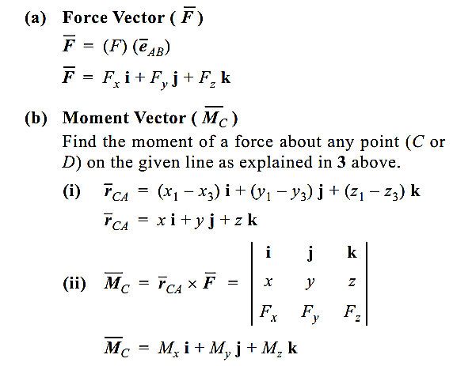
Moment of a force about a given line
Fig 4: Moment of a force about a given line^{[1]}

Slide 10
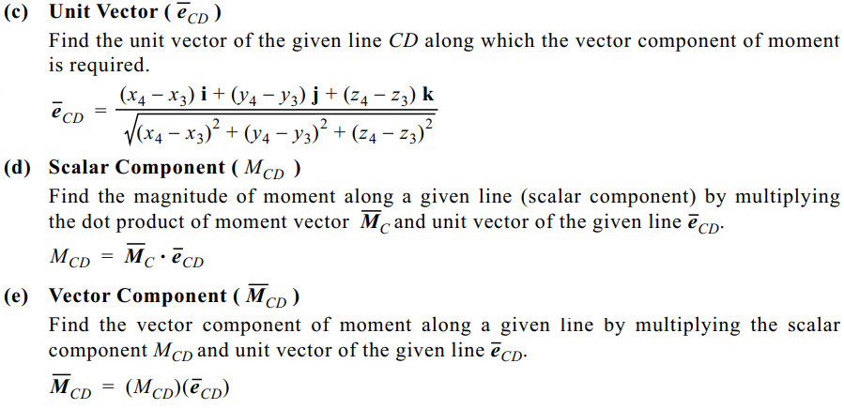
Moment of a force about a given line
Fig 4: Moment of a force about a given line

Slide 11
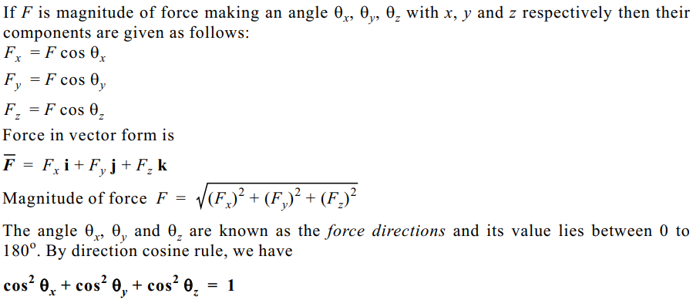
Magnitude of force and their direction

Slide 12
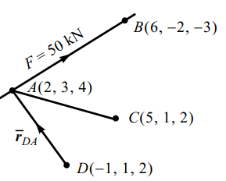
Numerical on Vector component of force about a line, moment of given force about a point
Q. 1) A force of 50 kN magnitude is acting at the point A(2, 3, 4) m towards point B(6, -2, -3) m.
Determine:
i) Vector component of this force along the line AC. Point C is (5, 1, 2) m.
ii) Moment of given force about a point D(-1, 1, 2) m.
Fig 5: Vector component of a force about a given point^{[1]}

Slide 13
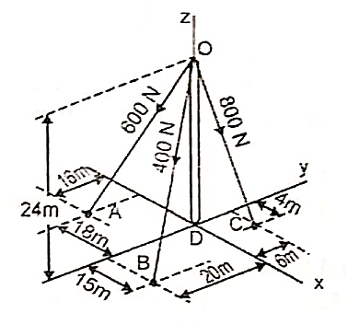
Numerical on Forces in Space (Concurrent space forces)
Q. 2 The tower is held place by three cables. If the force of each cable acting on the tower is shown fig., Determine the resultant.
Fig 6: Resultant for Non – Coplanar, concurrent force system^{[2]}

Slide 14
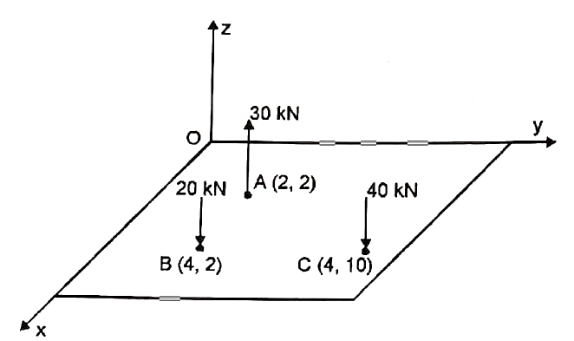
Numerical on Forces in Space (Resultant of parallel space forces)
Q. 3 Three forces 20 kN, 30 kN and 40 kN act normal to x-y plane as shown in fig. Determine the magnitude and direction and point of application of resultant force.
Fig 7: Resultant for Non – Coplanar, parallel force system^{[2]}

Slide 15
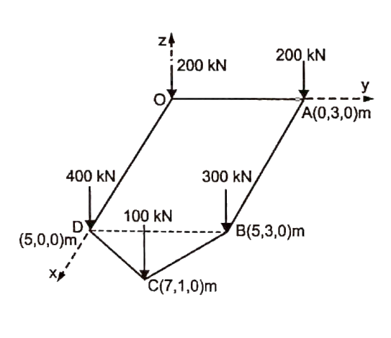
Numerical on Forces in Space (Resultant of parallel space forces)
Q. 4 A plate foundation is subjected 5 vertical forces as shown in fig. Replace these five forces by a means of single vertical force and determine the point of replacement.
Fig 8: Resultant for Non – Coplanar, parallel force system^{[2]}

Slide 16
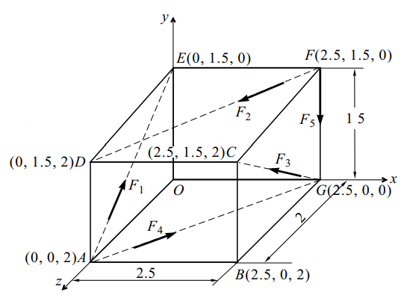
Numerical on Forces in Space (Resultant of General force system in Space)
Q. 5 Forces F1 = 1 kN, F2 = 3 KN, F3 = 2 kN, F4 = 5 kN and F5 = 2 kN act
along the line joining the centres
of the parallel piped whose side are
2.5 m, 2 m and 1.5 m as shown in Fig. Determine the resultant force and the moment of the resultant couple at the origin O.
Fig 9: Resultant for Non – Coplanar, Non - concurrent force system^{[1]}

Slide 17
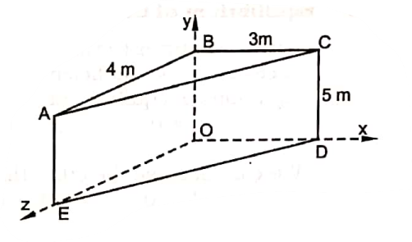
Numerical on Forces in Space (Resultant of General force system in Space)
Q. 6 The following forces act on the block shown in fig.
F1 = 40 kN at point C along CD,
F2 = 30 kN at point D along DB and
F3 = 100 kN at point D along DE. Determine the resultant force and resultant moment of these forces acting at O.
Fig 10: Resultant for Non – Coplanar, Non - concurrent force system^{[2]}

Slide 18
References
Engineering Mechanics, N. H. Dubey, Mc Graw Hill Education (India) Pvt. Ltd., page no: 4.2 to 4.30.
Engineering Mechanics, M. D. Dayal, chapter 7, Space Forces, page no. 157 to 179.

